Slide 1

First Result from
the Alpha Magnetic Spectrometer (AMS) Experiment
on the International Space Station.
ISS: 109 m x 80 m
Cost: $ 100 billion
Life time 20 years
F.Palmonari, on behalf of the AMS Collaboration Bologna, 6/5/2013

Slide 2
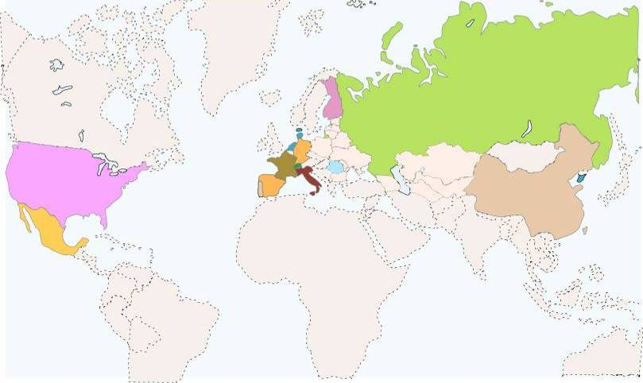
AMS: a U.S. DOE sponsored international collaboration
FINLAND
HELSINKI UNIV.
UNIV. OF TURKU
RUSSIA
I.K.I.
ITEP
KURCHATOV INST.
MOSCOW STATE UNIV.
DENMARK
UNIV. OF AARHUS
NETHERLANDS
ESA-ESTEC
NIKHEF
NLR
GERMANY
RWTH-I
RWTH-III
MAX-PLANK INST.
UNIV. OF KARLSRUHE
KOREA
USA
EWHA
KYUNGPOOK NAT.UNIV.
MIT - CAMBRIDGE
NASA JOHNSON SPACE CENTER
TEXAS A&M UNIVERSITY
UNIV. OF HAWAII
UNIV. OF MARYLAND - DEPT OF PHYSICS
YALE UNIVERSITY - NEW HAVEN
FRANCE
ROMANIA
ISS UNIV. OF BUCHAREST
GAM MONTPELLIER
LAPP ANNECY
LPSC GRENOBLE
TURKEY
METU
CHINA
BISEE (Beijing)
IEE (Beijing)
IHEP (Beijing)
NLAA (Beijing)
SJTU (Shanghai)
SEU (Nanjing)
SYSU (Guangzhou)
SDU (Jinan)
SWITZERLAND
ETH-ZURICH
UNIV. OF GENEVA
SPAIN
TAIWAN
CIEMAT - MADRID
I.A.C. CANARIAS.
ITALY
ACAD. SINICA (Taiwan)
AIDC (Taiwan)
CSIST (Taiwan)
NCU (Chung Li)
NCKU (Tainan)
NCTU (Hsinchu)
NSPO (Hsinchu)
ASI
CARSO TRIESTE
IROE FLORENCE
INFN & UNIV. OF BOLOGNA
INFN & UNIV. OF MILANO
INFN & UNIV. OF PERUGIA
INFN & UNIV. OF PISA
INFN & UNIV. OF ROMA
INFN & UNIV. OF SIENA
MEXICO
UNAM
PORTUGAL
LAB. OF INSTRUM. LISBON
Strong support from
NASA (D. Goldin, C. Bolden, L. Garver, G. Abbey, W. Gerstenmaier, M. Sistilli, T. Martin, K. Bollweg, …)
and DOE (J. Siegrist, M. Salamon, D.Kovar, S. Gonzalez, R. Staffin, J. O’Fallon, …)
Notes:
2

Slide 3



Italy in AMS
Trento
LNL
Milano
Bologna,CNAF
Pisa
Perugia
Terni
Roma
60 Scientists and Engineers
6 Universities
5 INFN Sections
2 INFN National Laboratories
1 INFN Computing center
16 years of collaboration among INFN and ASI
LNS

Slide 4
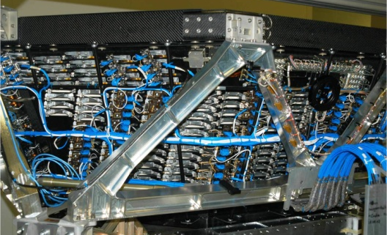
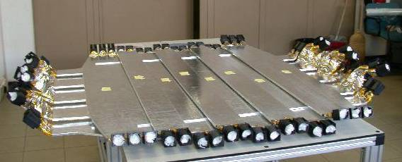
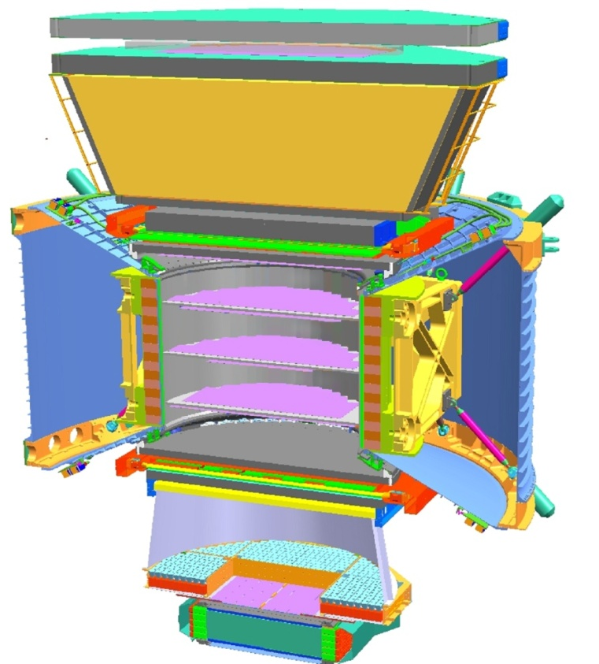
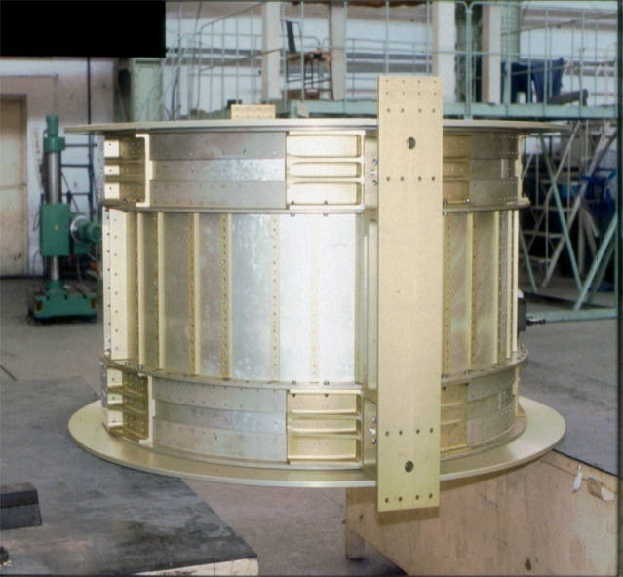
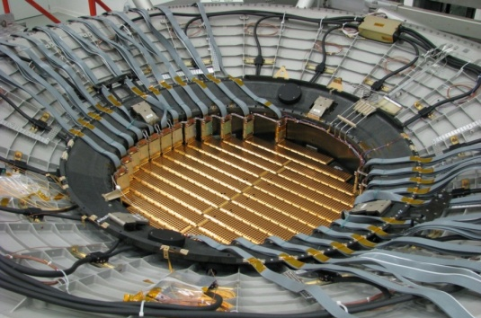
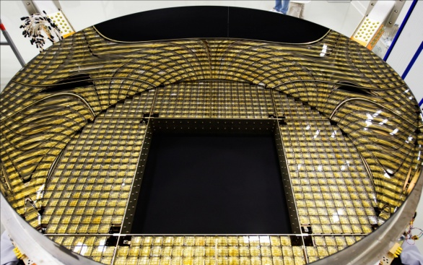
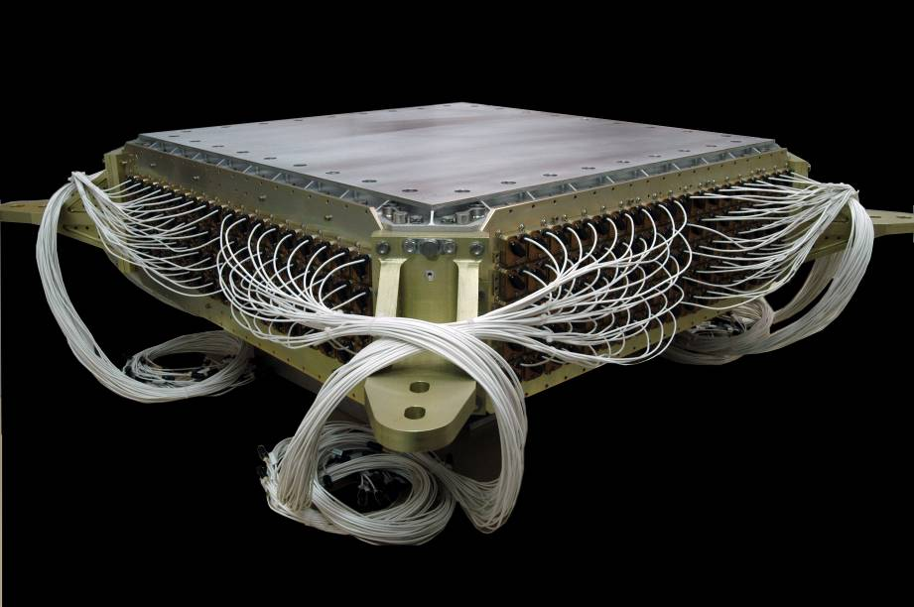
AMS: A TeV precision, multipurpose spectrometer
TRD
Identify e⁺, e⁻
Particles and nuclei are defined by their
charge (Z) and energy (E ~ P)
TOF
Z, E
1
Magnet
±Z
Silicon Tracker
Z, P
TRD
TOF
2
3-4
5-6
Tracker
7-8
TOF
RICH
Z, E
ECAL
E of e⁺, e⁻, γ
RICH
9
ECAL
Z, P are measured independently by the Tracker, RICH, TOF and ECAL
Notes:
4
4
4

Slide 5
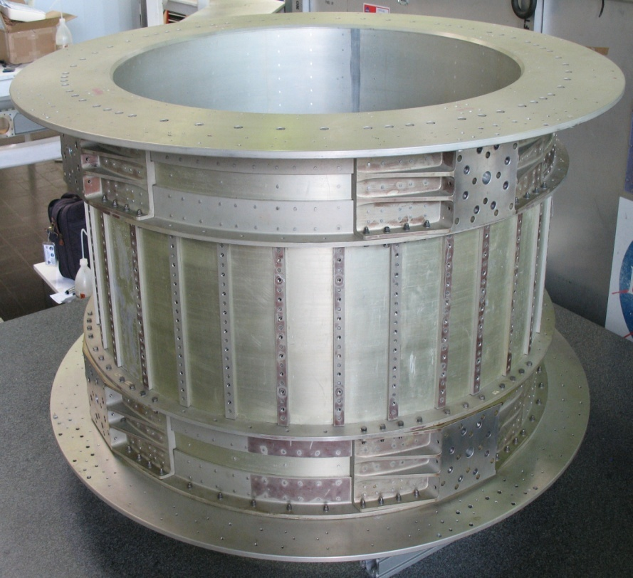
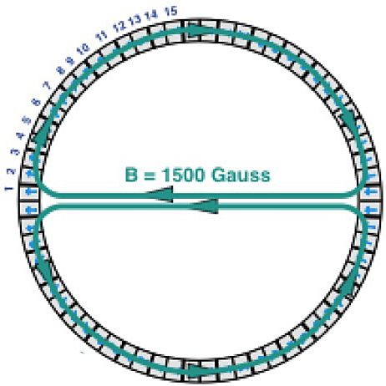
The Magnet
1. Stable: no torque
2. Safety : no field leak out of the magnet
3 . Low weight: no iron
The detailed 3D field map (120k locations)
was measured in May 2010
It was found that the deviation from the 1997 measurement had
remained the same to <1%
Notes:
B field measurement from Kounine talk @ PANIC

Slide 6
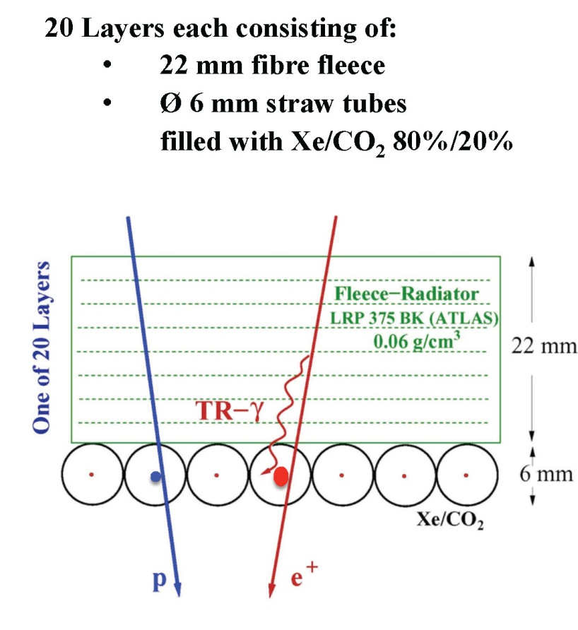

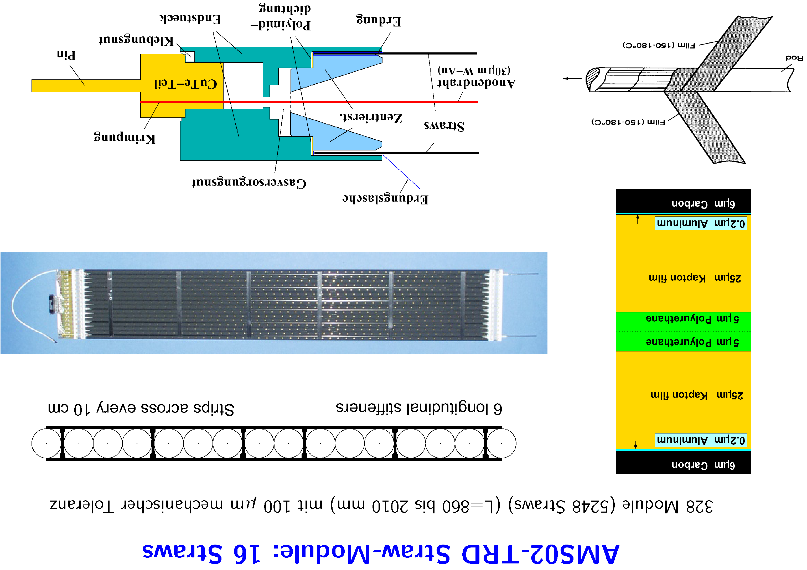
Transition Radiation Detector (TRD) Identifies Positrons, Electrons by transition radiation and Nuclei by dE/dX
5,248 tubes selected from 9,000, 2 m length centered to 100μm, verified by CAT scanner

Slide 7
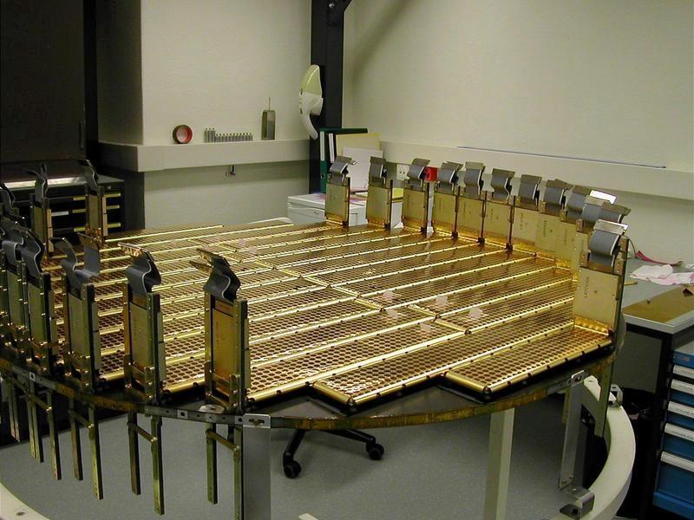
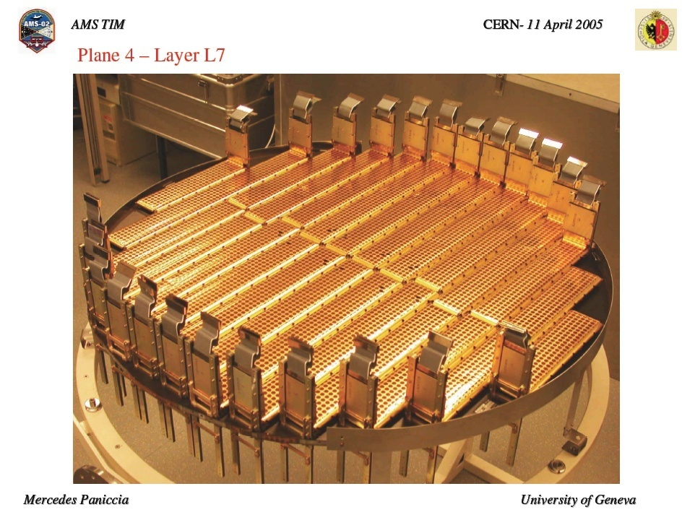
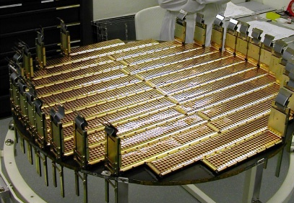
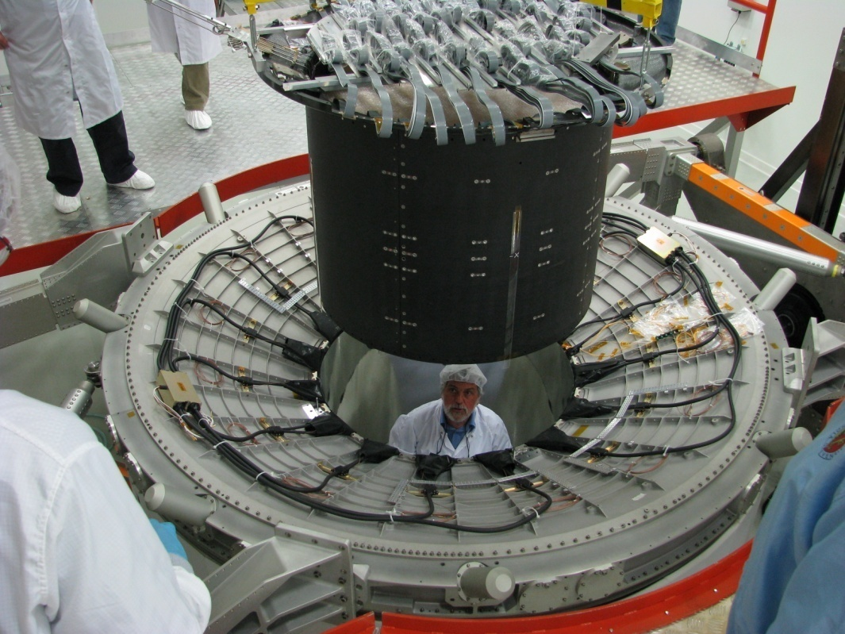
There are 9 planes with 200,000 channels aligned to 3 microns
Notes:
7
7

Slide 8
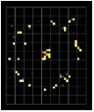

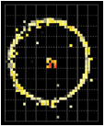
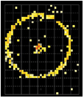
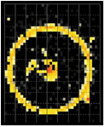
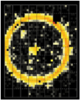
Ring Imaging CHerenkov (RICH)
160 GV
He
Li
C
10,880 photosensors
to identify nuclei and their energy
O
Ca
L’ing Laurenti ha diretto la delicatissima costruzione dello Specchio

Slide 9
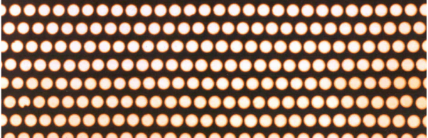
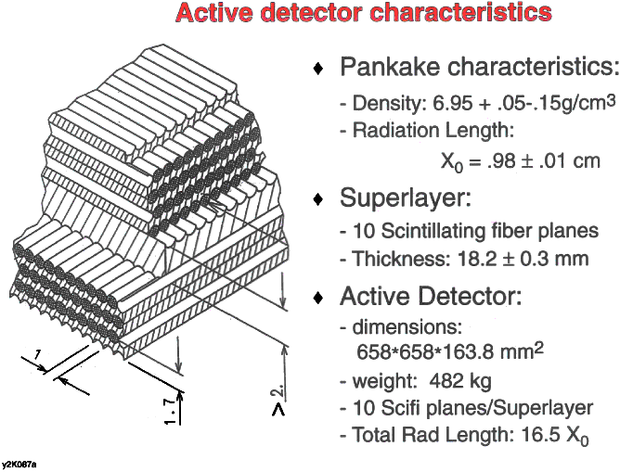
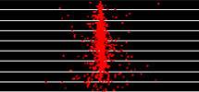
Calorimeter (ECAL)
A precision, 3-D measurement of the directions and energies of light rays and electrons
up to 1 TeV
e±
Lead foil
(1mm)
50,000 fibers, φ = 1 mm
distributed uniformly Inside 600 kg of lead
Total 17 X0
Fibers
(φ1mm)
e

Slide 10
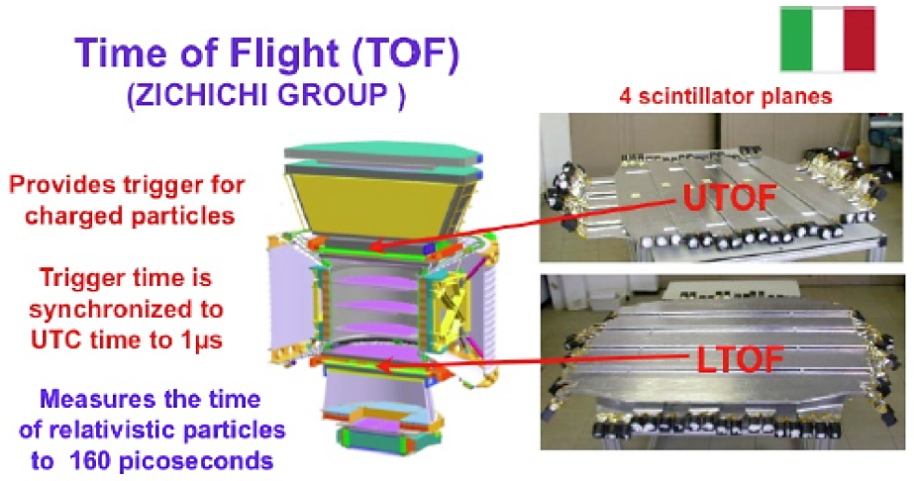

Slide 11
The Bologna INFN&University group work in AMS
A short story of 16 years of work to design, construct and mount in AMS the TOF system
The Bologna group formed and entered in the international collaboration AMS for Antimattar Search in Cosmic Rays, in 1995

Slide 12
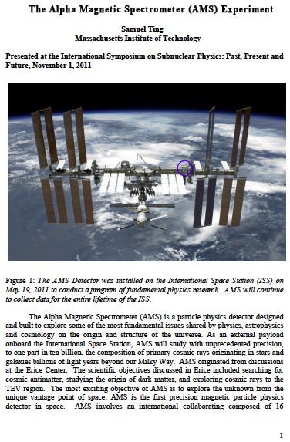

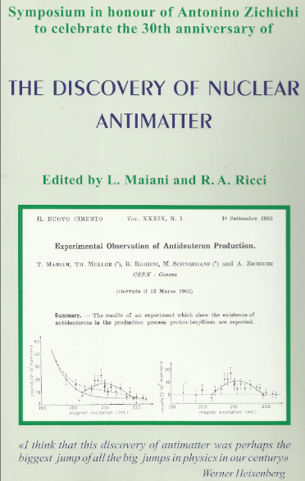

Slide 13
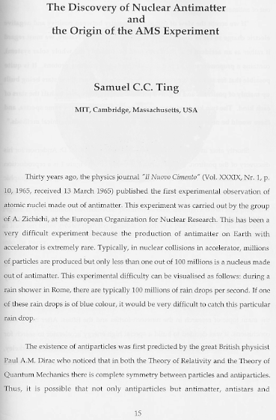
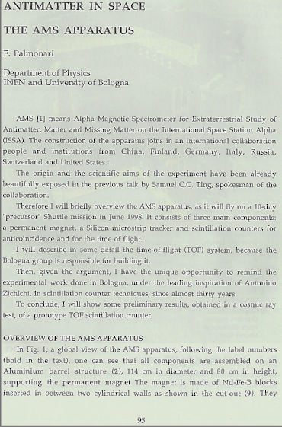

Slide 14
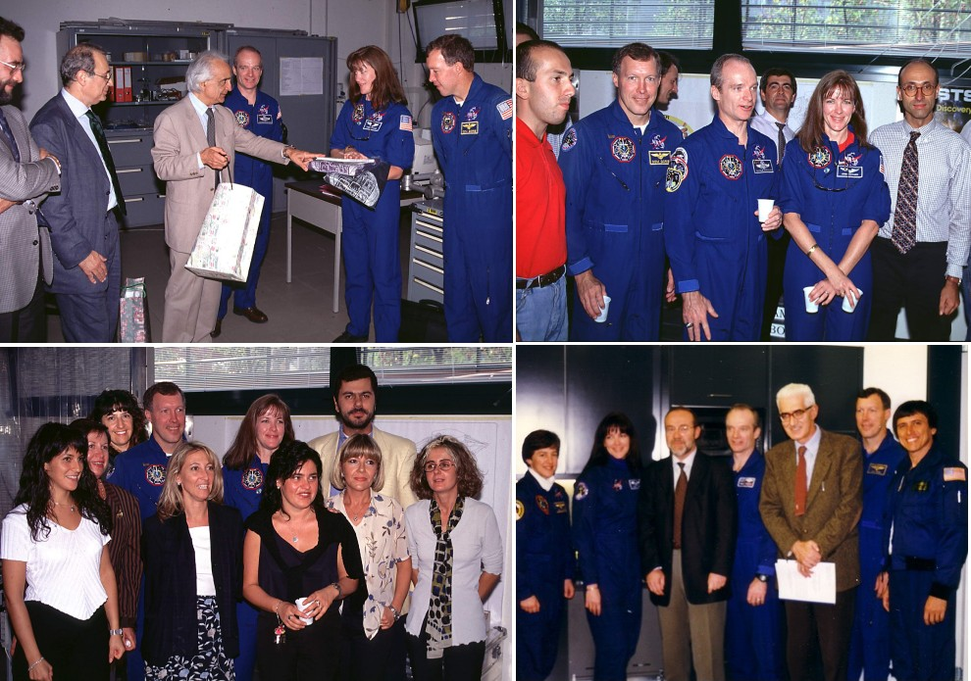
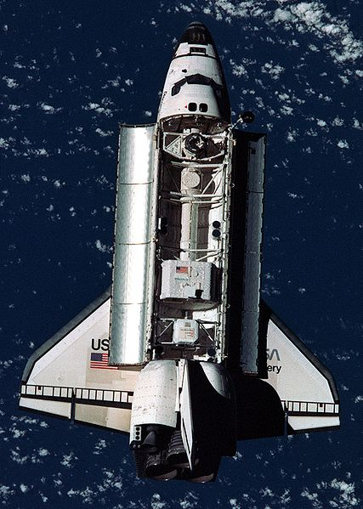
The TOF system for the precursor mission AMS-01 was assembled in Bologna in less than 2 years
AMS-01 succesful flight in june 1998
The STS91 crew in Bologna

Slide 15
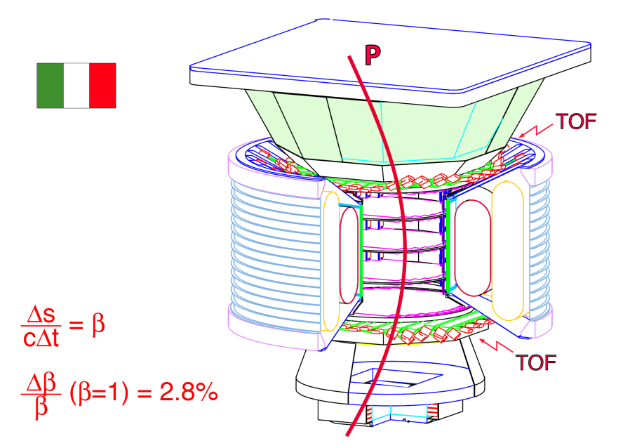
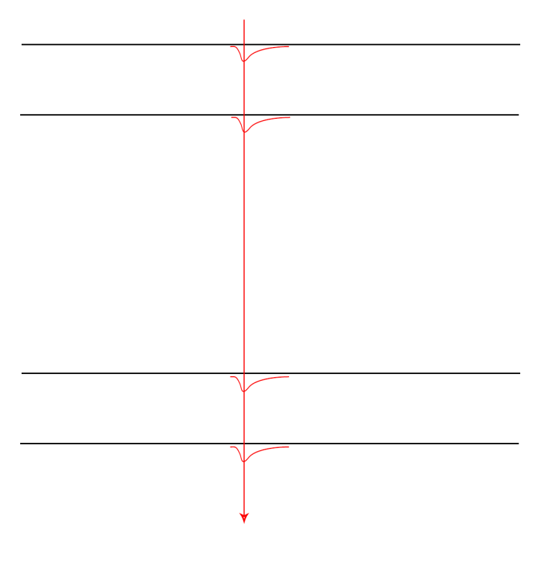
Principle of the measurement
time
amplitude
time
amplitude
Δs
β=
cΔt
time
amplitude
time
amplitude
σ=3.6%
charge
Z= ampl

Slide 16
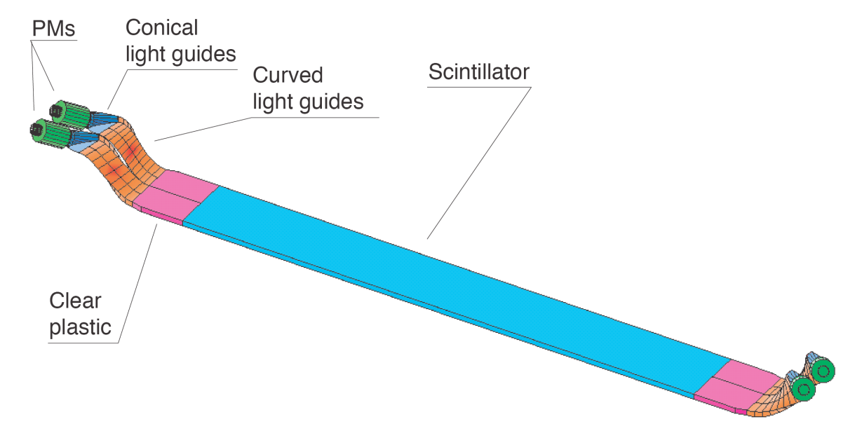
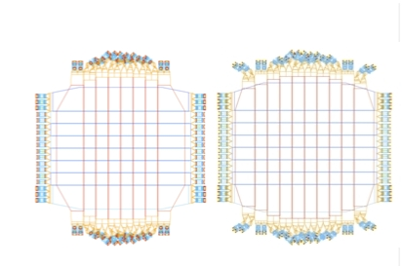
The TOF Apparatus
To cover the full solid angle of AMS-02, each TOF plane has a surface of about 1.4 m².
Each counter is 12 cm wide and overlaps by 0.5 cm with adjacent counters.
Four scintillator planes:
1) 8 counters, 36 PMTs
2) 8 counters, 32 PMTs
3) 10 counters, 40 PMTs
4) 8 counters, 36 PMTs
UpperTOF
LowerTOF
The system have been designed for maximum redundancy to ensure the fast trigger to AMS even in presence of HV, PMT or front-end electronics faults:
  Each counter is 4-fold redundant in PMTs
  Each HV power supply is doubly redundant
  Each coincidence signal for the fast trigger is doubly redundant
Notes:
Overlap
Redundancy

Slide 17
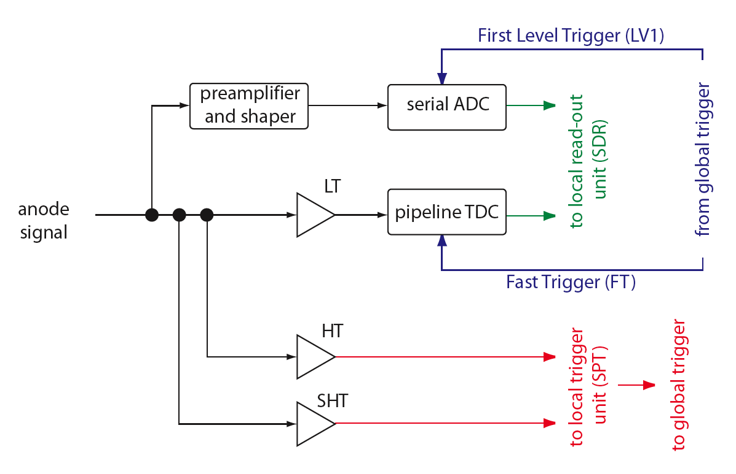
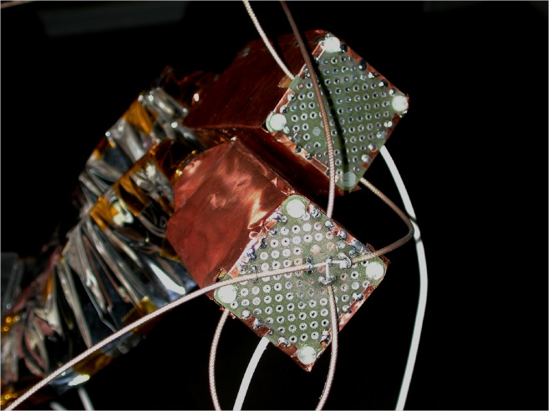
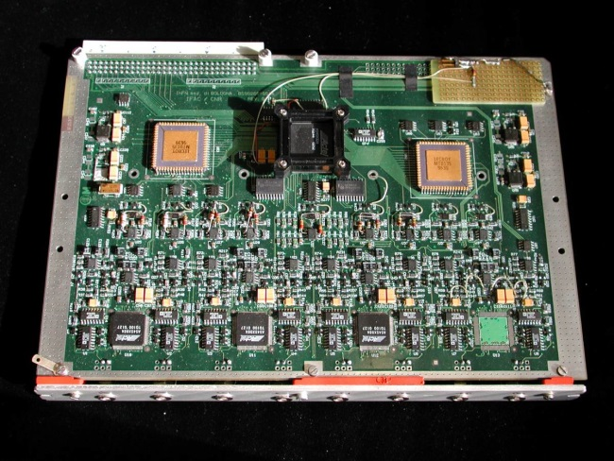
Read-out electronics
Dynode signals
Anode signal processing
HV
cables
Anode sum
Three thresholds are applied to the anode signal:
Low (LT): time measurement
High (HT): Z=1 selection
SuperHigh (SHT): Z>1 selection
The amplitude of the anode signal is also measured with an ADC.
The amplitude of each dynode signal is read-out on a card mounted inside the detector.

Slide 18
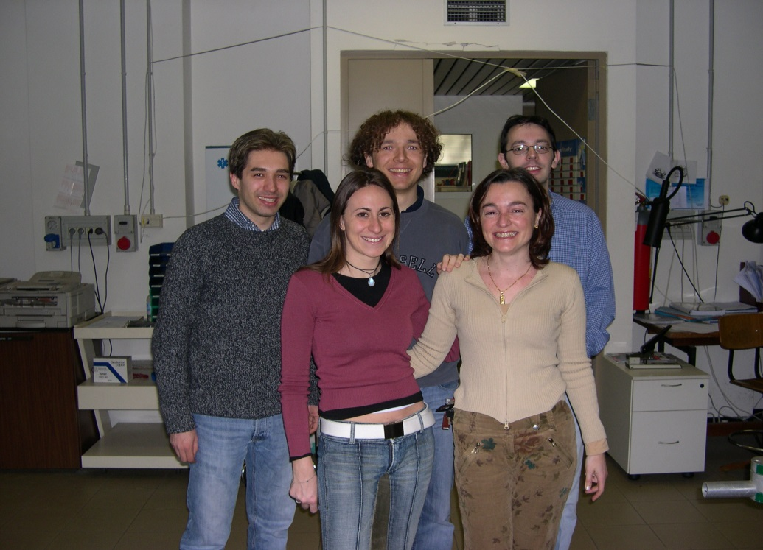
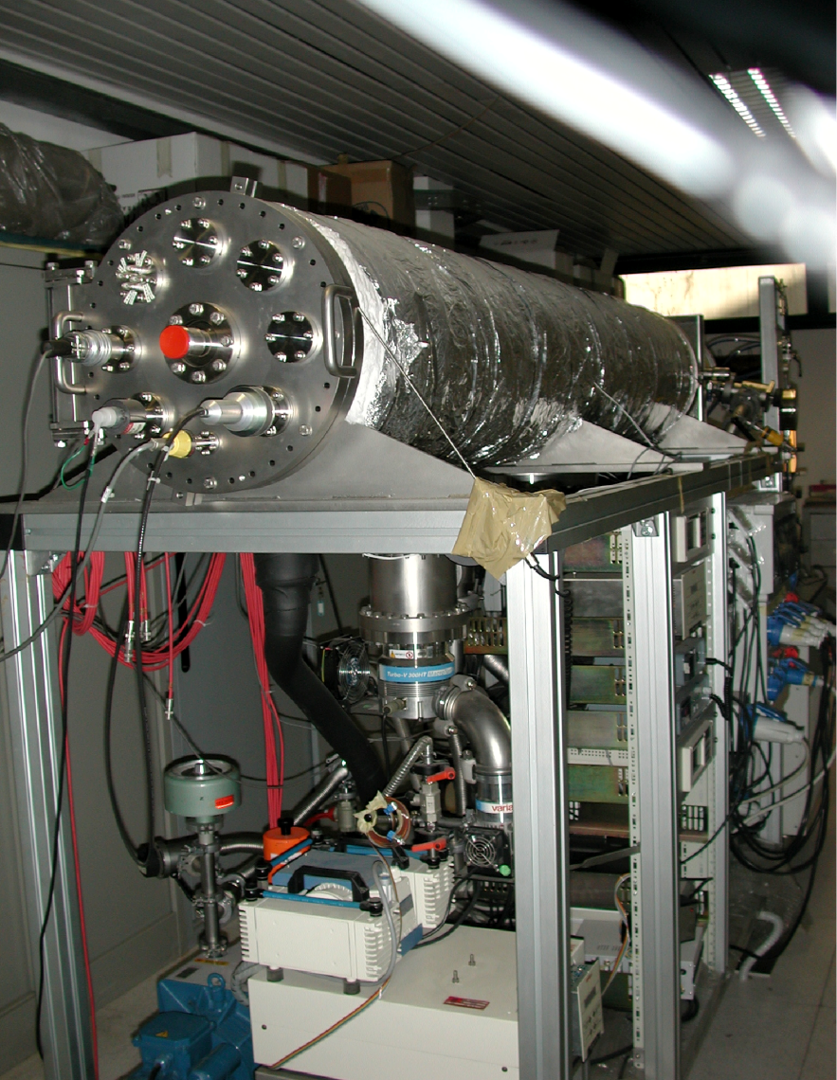
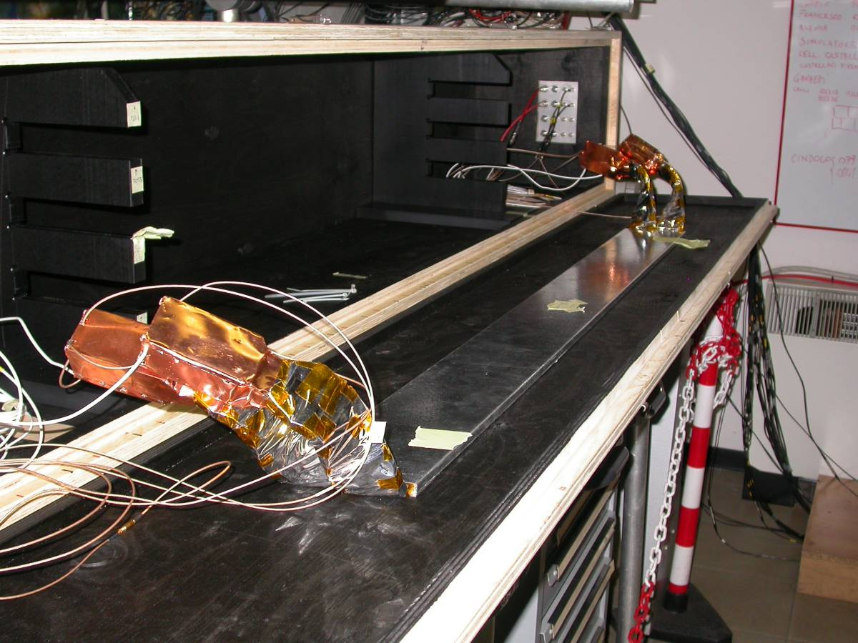
Counter calibration with cosmic rays
The 2003 calibration team of TOF counters

Slide 19
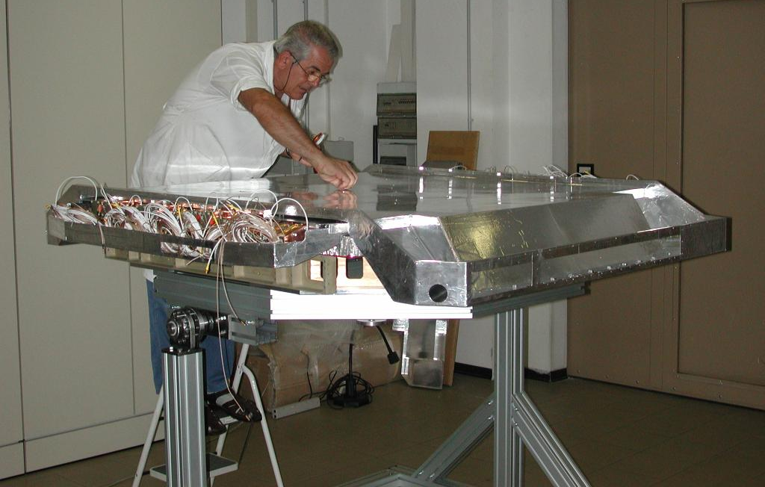
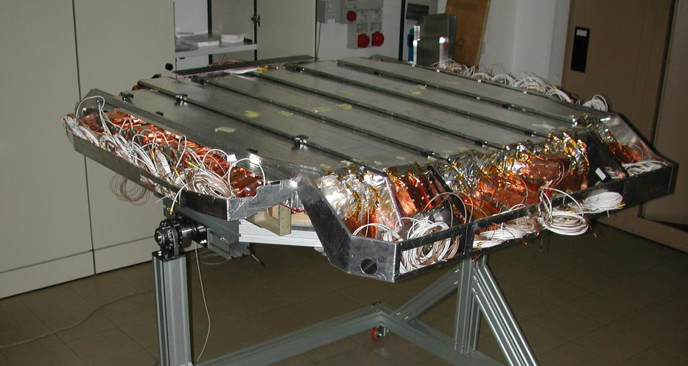
Lower TOF assembly - Plane 3
Plane 3 carbon fiber down cover
Plane 3 counters

Slide 20
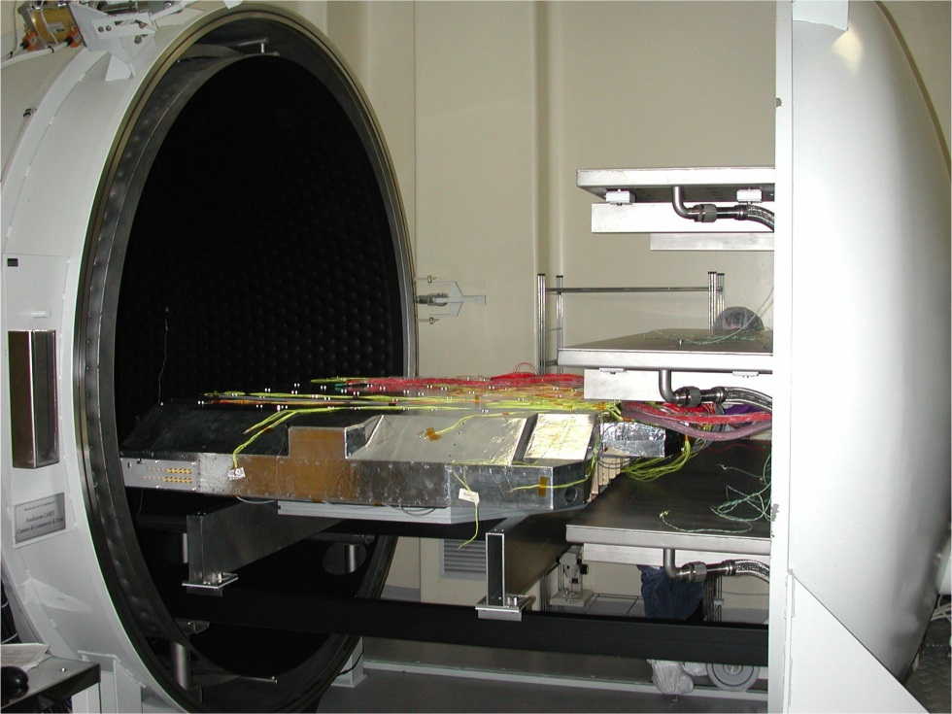
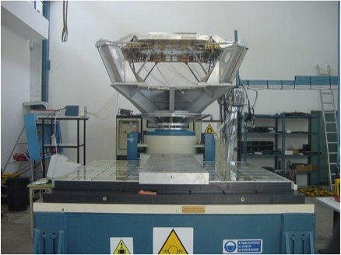
Full Thermal Vacuum & Vibration Tests
Vacuum ≈10⁻⁵ mbar
+50º
+45º
-30º
-30º
The vibration test has been performed along the three axes (X,Y,Z) with the Maximum Expected Flight Level specifications during shuttle launch.

Slide 21
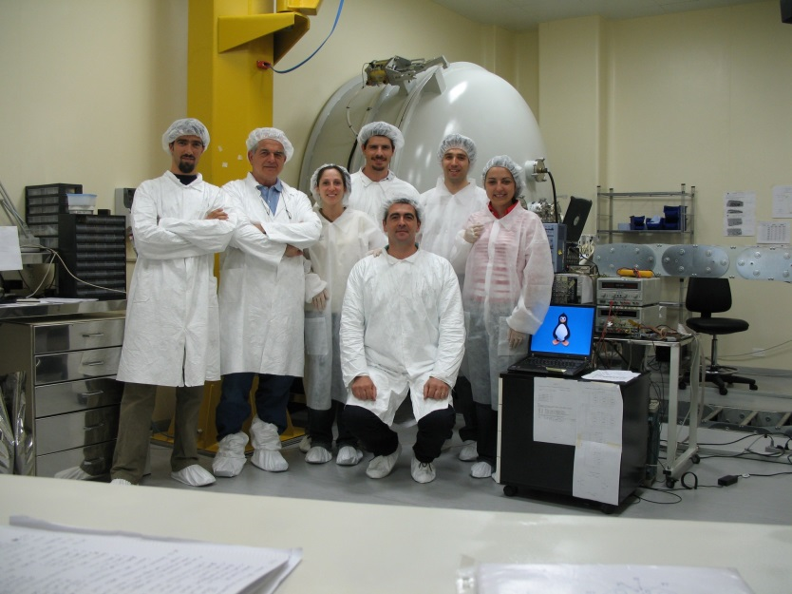
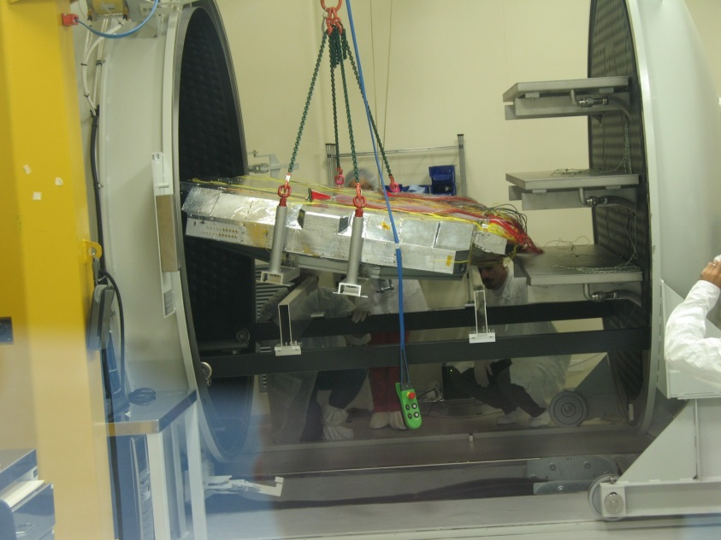
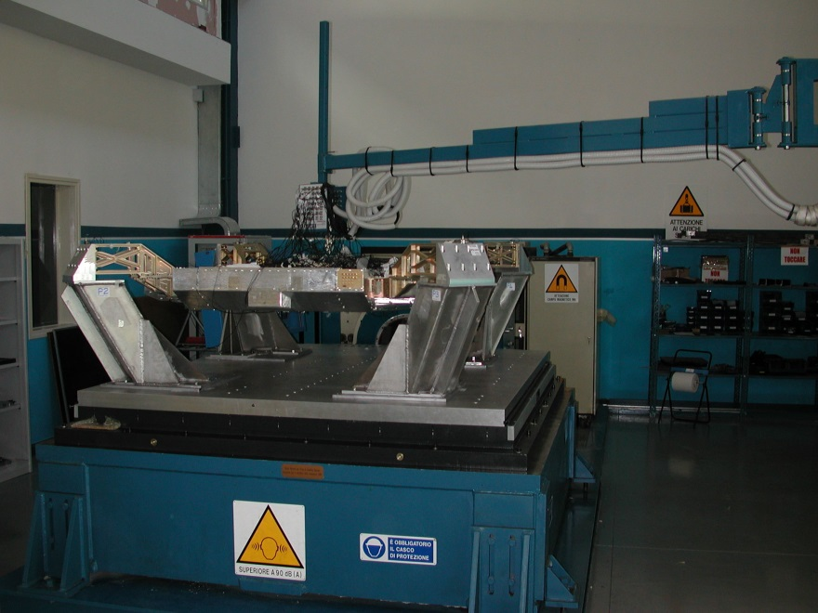
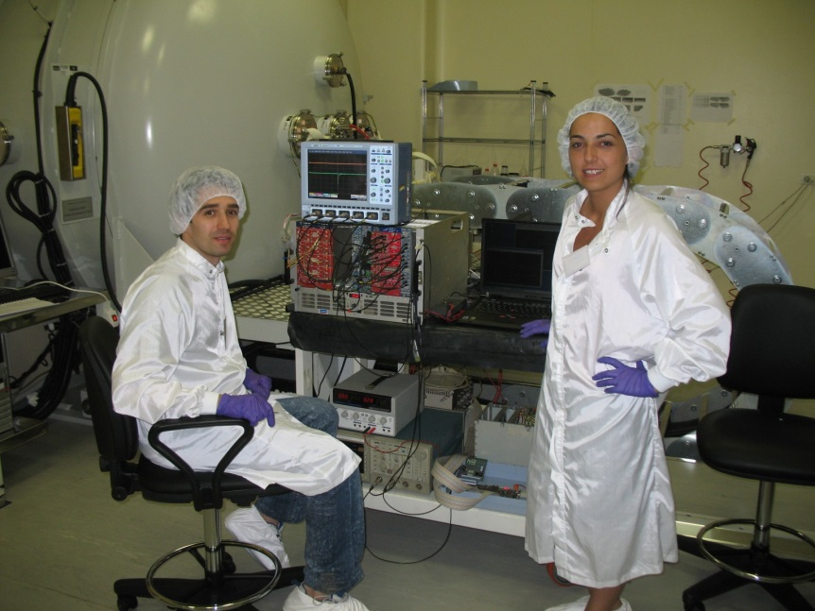
The thermo-vacuum and vibration tests team in Terni 2005

Slide 22
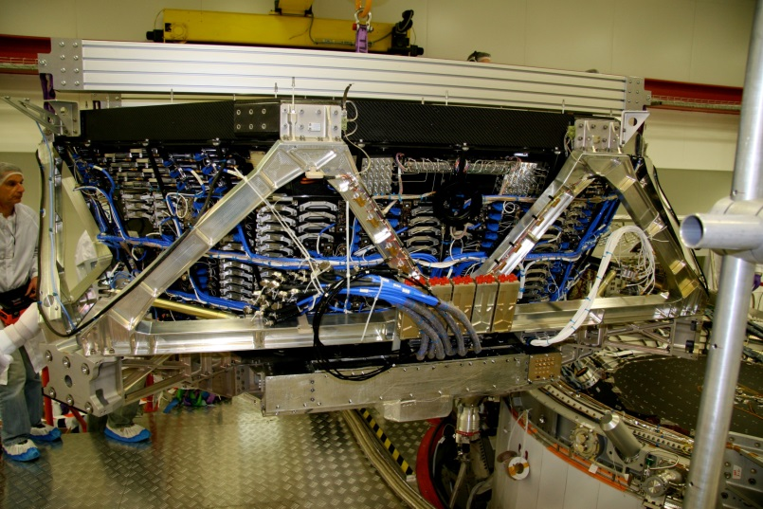


Detector integration
5m x 4m x 3m
7.5 tons
UTOF+TRD
LTOF+RICH+ECAL

Slide 23




Mounting TOF in the AMS Clean Room at CERN 2007

Slide 24

AMS in the ESA Thermal Vacuum Chamber, April 2010
Duration 14 Days
P < 10⁻⁹ bar
Ambient temperature
from -90ºC to +40ºC
Strong support from ESA (JJ Dordain, S. DiPippo, M. Zell)

Slide 25
Finally, the permanent magnet was selected
April 2010:
Test results in ESTEC showed that the life of the Superconductiong Magnet was 20±4 months (with 2500 liters of superfluid He)
NASA decided to increase the life of ISS up to 2028

Slide 26



NASA Associate Administrator for Space Operations William Gerstenmaier visited AMS more than 10 times:
19 June 2011,
1 June 2011,
10 May 2011,
26 October 2010,
15 February 2010,
19 January 2010,
5 July 2009,
1 November 2007,
12 May 2003
26

Slide 27

Intensive Tests at CERN
Strong support from CERN (R. Heuer, A. Siemko, S. Meyers, C. Garguilo)

Slide 28




26 august 2010 - from Geneva to NASA JFK on the biggest USA Cargo C5 Galaxy

Slide 29

At KSC, AMS mated with the ISS Payload Attach System simulator
KSC, October 22, 2010

Slide 30

Endeavour: 110 t
External tank: 756 t
2 SRB: 1142 t
(solid rocket boosters)
Total weight: 2008 t
AMS weight: 7.5 t

Slide 31


After 123 seconds,
1,000 tons of fuel is spent.
May 16, 2011

Slide 32

Finally AMS-02 in space!
16 may 2011 in Bologna

Slide 33


May 19, 2011: AMS installation completed.

Slide 34






AMS Operations
Astronaut at ISS AMS Laptop
TDRS Satellites
AMS
Ku-Band
High Rate (down):
Events <10Mbit/s>
Flight Operations
Ground Operations
S-Band
Low Rate (up & down):
Commanding: 1 Kbit/s
Monitoring: 30 Kbit/s
White Sands Ground Terminal, NM
AMS Payload Operations Control and Science Operations Centers
(POCC, SOC) at CERN
AMS Computers
at MSFC, AL

Slide 35



One of the major challenges of operating on the Space Station is
the extreme thermal environment to which the experiment is exposed.
SUN
SUN
SUN
20º
:
0ºC
1.7.11
1.1.12

Slide 36

POCC at CERN in control of AMS since 19 June 2011

Slide 37

AMS POCC in continuous communication with MFSC and ISS Mission Control Center, JSC

Slide 38


From the Clean Room (2007) to the POCC (2011)
Bologna
Professors A. Contin, G. Laurenti, F. Palmonari

Slide 39
First Analysis from AMS
Over the first eighteen months of operations in space, AMS has collected over 25 billion events.
6.8 million are electrons or positrons.

Slide 40










All of the analysis of AMS data is being performed by two independent groups
Group A: RWTH-Aachen, Karlsruhe;
Bologna, Milan, Perugia, Pisa, Rome;
MET-Ankara;
Lisbon; …
Group α: MIT, Yale, Hawaii;
LAPP-Annecy, Grenoble;
Academia Sinica, NCU;
IHEP-Beijing;
Geneva;
CIEMAT-Madrid; …

Slide 41

The positron fraction grow at high energy is challenging

Slide 42

Physics of Positron Fraction
M. Turner and F. Wilczek, Phys. Rev. D42 (1990) 1001;
J. Ellis, 26th ICRC Salt Lake City (1999) astro-ph/9911440;
H. Cheng, J. Feng and K. Matchev, Phys. Rev. Lett. 89 (2002) 211301;
S. Profumo and P. Ullio, J. Cosmology Astroparticle Phys. JCAP07 (2004) 006;
D. Hooper and J. Silk, Phys. Rev. D 71 (2005) 083503;
E. Ponton and L. Randall, JHEP 0904 (2009) 080;
G. Kane, R. Lu and S. Watson, Phys. Lett. B681 (2009) 151;
D. Hooper, P. Blasi and P. D. Serpico, JCAP 0901 025 (2009) 0810.1527; B2
Y–Z. Fan et al., Int. J. Mod. Phys. D19 (2010) 2011;
M. Pato, M. Lattanzi and G. Bertone, JCAP 1012 (2010) 020.
χ + χ → e⁺ + ….
mχ=800 GeV
Positron fraction
e⁺ /(e⁺ + e⁻)
mχ=400 GeV
0.1
Collision of Cosmic Rays
Dark Matter model based on I. Cholis et al., arXiv:0810.5344
10
10²
e± energy [GeV]

Slide 43
“First Result from the AMS on the ISS: Precision Measurement of the Positron Fraction in Primary Cosmic Rays of 0.5-350 GeV”
Selected for a
Viewpoint in Physics and
an Editors’ Suggestion [Aguilar,M. et al (AMS Collaboration) Phys. Rev. Lett. 110, 1411xx (2013)]

Slide 44

Sensitive Search for the origin of Dark Matter with p/e⁺ >10⁶
p
Tracker Entry
TRD:
P
rejection >10²
e⁺
TRD
TOF
0.33 X₀
p
e⁺
Tracker Total
e⁺
Tracker
0.50 X₀
TOF
RICH
ECAL
P
Tracker Exit
ECAL:
e⁺
rejection >10⁴
a) Minimal material in the TRD and TOF
So that the detector does not become a source of e⁺.
b) A magnet separates TRD and ECAL so that e⁺ produced in TRD will be swept away and not enter ECAL
In this way the rejection power of TRD and ECAL are independent
c) Matching momentum of 9 tracker planes with ECAL energy measurements

Slide 45




Data from ISS Time of Flight System
Measures Velocity and Charge of particles
x10³
Events
σ_{β}=2%
σ_{Time}=80ps
Events
σ_{β}=1.2%
σ_{Time}=48ps
Z=2
Z=6
TOF 1 and 2
Velocity [Rigidity>20GV]
Velocity [Rigidity>20GV]
H
He
C
O
TOF 3 and 4
Li
B
N
Be
Ne
Mg
F
Na
Si
Mn
Plane 4
Al
S
Fe
P
Cl
Ar
Ca
Ti
V
K
Cr
3, 4
Sc
Ni
Zn

Slide 46

TRD performance on ISS
Proton rejection at 90% e⁺ efficiency
ε_{e}
70%
• ISS data
80%
90%
Rigidity (GV)
Notes:
46
46

Slide 47

Data from ISS: Proton rejection using the ECAL

Slide 48






Tracker: The coordinate resolution is 10 μ Inner Tracker Alignment via
20 –UV Lasers
Outer Tracker Alignment via
Cosmic rays
1
2
3
4
TRD
TOF
5
6
TRACKER
MAGNET
7
8
TOF
RICH
9
ECAL

Slide 49

Stability of the alignment on Tracker plane 1 & 9

Slide 50
Analysis strategy
AMS has 3 powerful indipendent selectors, based on beam calibrations data, to separate electrons and positrons from overwelming protons and ions
TRD - > TRD-Likelihood selector
ECAL - > ECAL-ShowerShape BDT
TRK - > Ratio E/p
Two different strategies have been pursued
Analysis based on CUTS to separate p, e+,e-, Z>1 populations and count the numbers of e+ and e-
Analysis based on TEMPLATES of the populations to fit their distributions.
The published positron fractions have been calculated using the template approach to gain in statistics

Slide 51




Electron E=1.1 GeV
Positron E=1.1 GeV
Run/Event 1315150703/ 667540
Run/Event 1316182344/ 919896
front
view
side
view
front
view
side
view

Slide 52




Electron E=982 GeV
Positron E=636 GeV
Run/Event 1329775818/ 60709
Run/Event 133119-743/ 56950
front
view
side
view
front
view
side
view

Slide 53

Example of Positron Selection:
The TRD Estimator shows clear separation between protons and positrons with a small charge confusion background
Events
positrons
protons
TRD Estimator (83.2-100 GeV)

Slide 54
Systematic errors to positron fraction
Acceptance asymmetry
  Difference between positron and electron acceptance due to known minute tracker asymmetry
Selection dependence
  Dependence of the result on the cut values
Migration bin-to bin
  Migration of electron and positron events from the neighboring bins affects the measured fraction
Reference spectrum
  Definition of the reference spectra is based on pure samples of electrons and protons of finite statistics
Charge confusion
  Two sources: large angle scattering and production of secondary tracks along the path of the primary track. Both are well reproduced by MC. Systematic errors correspond to variations of these effects within their statistical limits.

Slide 55

Systematic error on the positron fraction:
4. Reference spectra
Probability
electron
proton
TRD estimator
Definition of the reference spectra is based on pure samples of electrons and protons of finite statistics.

Slide 56

Systematic error on the positron fraction:
5. Charge confusion
− MC simulation
  Two sources: large angle scattering and production of secondary tracks along the path of the primary track. Both are well reproduced by MC. Systematic errors correspond to variations of these effects within their statistical limits.

Slide 57
Exemple of analysis done by our Bologna group Time stability in 4 days time slices
Positron fraction E=20-100 GeV (cuts selection)

Slide 58


Slide 59
Positron events, positron fraction in each energy bin

Slide 60

Positron fraction
A new phenomena has occurred
10
e± energy [GeV]

Slide 61
In conclusion, the first 6.8 million primary positron and electron events collected with
AMS on the ISS show:
At energies < 10 GeV, a decrease in the positron fraction with increasing energy.
ii. A steady increase in the positron fraction from 10 to ∼250 GeV.
iii. The determination of the behavior of the positron fraction from 250 to 350 GeV
and beyond requires more statistics.
iv. The slope of the positron fraction versus energy decreases by an order of magnitude from 20 to 250GeV and no fine structure is observed.
v. The positron fraction spectrum is consistent with e± fluxes each of which is the sum of its diffuse spectrum and a single common power law source.
vi. The positron to electron ratio is consistent with isotropy; δ ≤ 0.036 at the 95% C.L.
These observations show the existence of new physical phenomena,
whether from a particle D3 physics or an astrophysical origin.

Slide 62
Next papers expected for the summar conferences
Their release sequence depends essentially on the amount of work needed to complete the analysis for the two indipendent groups: detection efficiencies, systematic corrections etc..:
The (positron+electrons) absolute flux study as function of energy
The study of light ions detection efficiency for e.g. the determination of the B/C ratio
The absolute flux of protons and He up to the maximum detectable rigidity of about 2 GV.

Slide 63
The excess of antimatter (positrons) has been observed for more than twenty years and has aroused much interest.
AMS is the first experiment to probe in detail the nature of this excess with its high sensitivity and precision.
We have observed many new phenomena in this positron spectrum. Soon, the origin of this excess will be understood.
It is very difficult in accelerators to do a 1% accuracy experiment. To do so in space is extremely challenging. It is the effort of the entire AMS collaboration with the support of NASA and CERN which is making this possible.
Their efforts made this possible

Slide 64









Many thanks to all AMS-Bologna TOF people wherever they are.

Slide 65
We want to quote all of them
Our PhD students
Diego Casadei , Veronica Bindi , Francesca Giovacchini, Lucio Quadrani, Nicolo’ Masi
INFN Directors
P.Giusti, A.Basile, A.Zoccoli, G.Bruni
Engineers
G. Laurenti, I. D’Antone,
A. Basili
Research Physicists
A.Margotti
F.Cindolo
C.Sbarra
D.Casadei
G.Castellini
G.Levi
V.Bindi
F.Palmonari
A.Contin
L.Quadrani
N.Masi
A.Zichichi
Technicians
L.Degli Esposti, C.Guandalini, S.Finelli, M.Lolli, F.Massera, G.Molinari, G.Pancaldi, R.Pilastrini, S.Zagato, A.Zucchini.
M.Tesi, F.Gabbanini
Our undergraduate students
Enrica Prati Daniela Minelli Luca Baldini Silvia Recupero Elisa Lanciotti Katia Molino Vincenzo Vitale Lorenza Patuelli Alessandro Montanari Roberto Martelli Michele Salvadore Nada Carota
Luca Amati
Alberto Oliva Lorenzo Villa
Dafne Baldassari

