Slide 1
Open Fronts
MonteCarlo
Fluxes analysis
Antip software
Unfolding
Rootfiles filtering
e/p TOF selection

Slide 2
MC
Proton MC rootfiles seem to have the real data minimum bias-total events proportion
Datacard
OPENCLOSE=3 //usually 3 (or 0): 0/1/2/3 = cern/notcern/all/ spec cite
PART=15 //particle id - 1:photon, 2:positron, 3:electron, 5:mu+, 14:proton, 15:antiproton,
47:He(4), 49:He3, 64:Be9, 67:Ca(12), 114:Be10 …etc…
PMIN=0.5 // minimum momentum in GeV
PMAX=10. //maximum momentum in GeV (<8000)
TIMBEG=20102011 // GMT time begin (Fri, 21 Aug 1970 15:53:31)
TIMEND=31122019 //GMT time end (Sun, 27 Dec 1970 05:00:19) – past history range for MC rootfiles – don’t touch
TOTALEVENTS=10000000 //from 10 millions to 10 billions (Trigger events)
CPUPEREVENTPERGHZ=0.16 //cpu per event per GHz, order of magnitude: 0.005 to 10,
// cern openclose=3 → 2.2 GHz (usually 0.15÷0.17)
// It’s important to use three momentum ranges, with correct CPU and Trigger values, for example:
0.5-10 GeV ----> CPU=0.007 trig=5*10^7 2 days
10-200 GeV ----> CPU=0.07 trig=3*10^7 11 days
200-4000 GeV ----> CPU=0.2 trig=10^7 11 days
following the formula to compute the time for MC rootfile production:
days=CPU*Trig/(2.2*60*60*24)=CPU*Trig/190080
Ambiguity: trigger or generic events

Slide 3
MCGEN 12=-0.8 13=$PMIN 14=$PMAX 15=1 19=$RUN 20=5 21=0 34=1 //onother uptodate configuration (best)
"MC particle generation" - Parameters for the particle production
12=$COST ---> max cos(theta) angle
34= ----> special acceptance cut
0 Default(None)
1 focus on ecal
2 focus on outer trd hc
3 focus on solar panel/ams
Connection trouble via web-tunnel: you have to do
$ ssh -v -L 2080:pcamss0.cern.ch:80 myname@lxplus.cern.ch (or cern.ch:23)
and then set a localhost:2080 proxy SOCKSv5 on your browser
antiprotons.g4.v5.B550
Fake epmz… Choutko: «strange, it seems they’re symbolic links »… && he modified antiproton for openclose 3, ready in 10 days
epmz.g4.v5.B550

Slide 4
Another way
$ ssh –XY myname@lxplus.cern.ch
$ firefox
Go to ams.cern.ch and MC production site

Slide 5
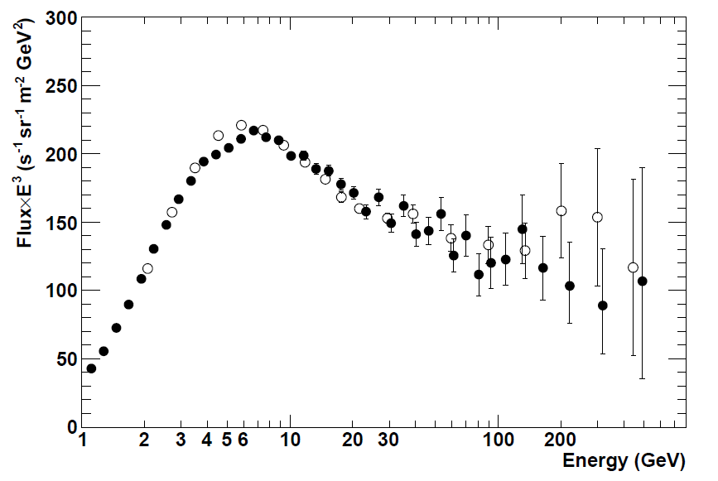
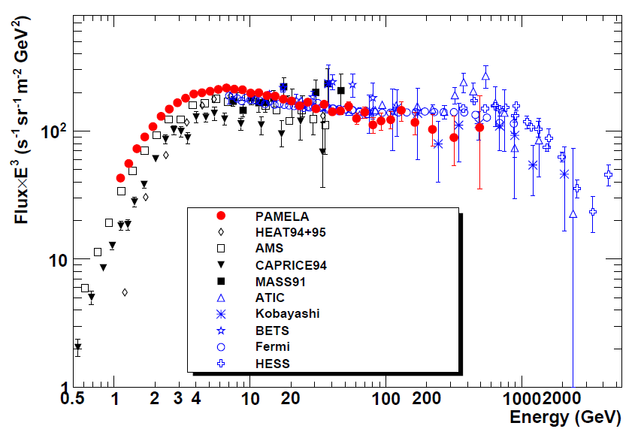
Fluxes Data: No Brand News in these 50 days of 2012
From PAMELA and FERMI
electron
Electron + positron

Slide 6
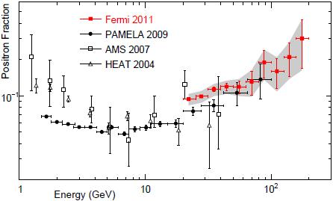
Positron fraction

Slide 7
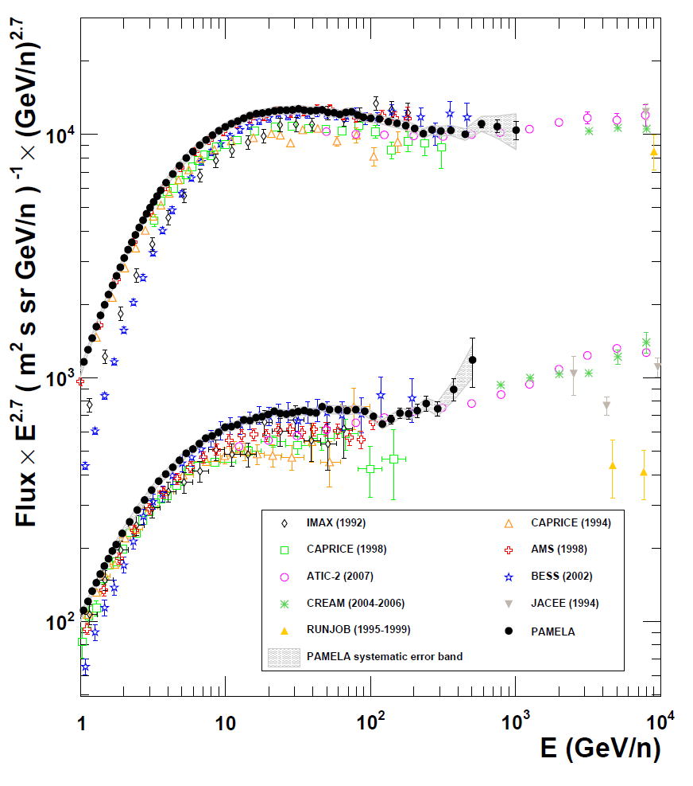
proton
helium

Slide 8
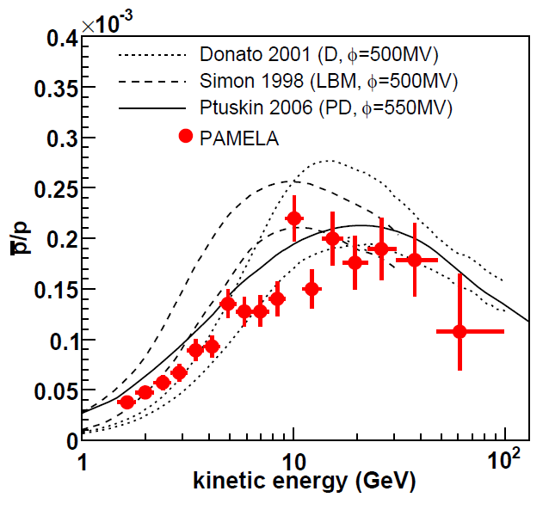
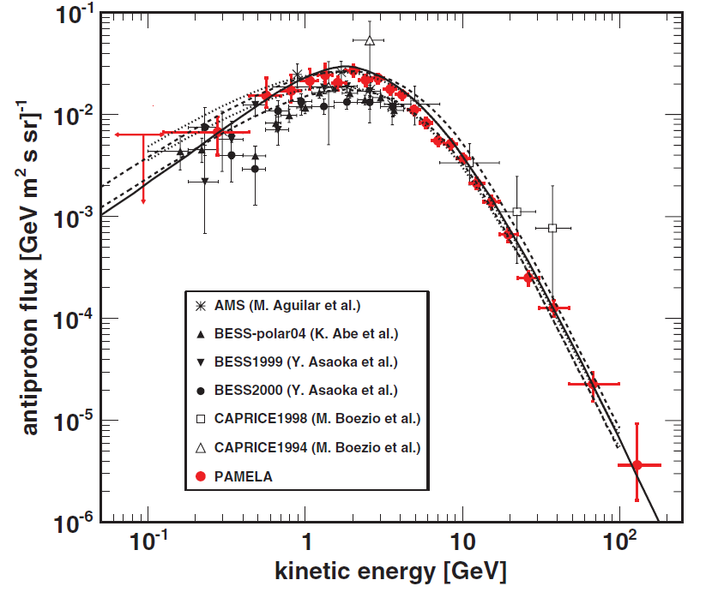
Antiproton/proton
Antiproton

Slide 9
Fluxes Analysis
Our analysis jobs
$${10}^{4 }around T\sim 1 GeV,$$
${10}^{3} for T>10 GeV$
Without ECAL, without acceptance factor

Slide 10
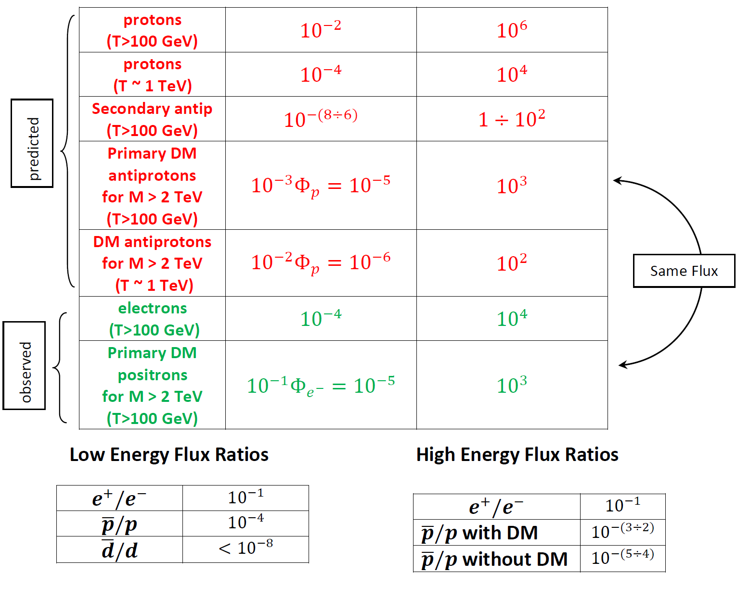
200 rootfiles
With a ${10}^{−1}$AMS acceptance factor
$${10}^{4}protons$$
$${ 10}^{3}$$
$$<1$$
10 antiprotons
$$1$$
$${10}^{2} electrons$$
$$10$$
Higher than antiprotons one
10
positrons
$$1$$

Slide 11
Antip selection
Software LOGIC: if Minimum Bias -> Golden Cuts
if Golden Cuts (and ECAL minimum/golden) -> Fundamental Particle CUTS:
Correct sign for momentum, rigidity and charge && E/p Ratio && MIP && Rigidity Asymmetry
if particle cuts -> SUBCUTS in function of Kinetic Energy: ECAL BDT && TRD likelihood for lepton-hadron separation, for T < 100 GeV
New Stuff
 Lorentz  calculation without beta
Different Tracker Mode

Slide 12
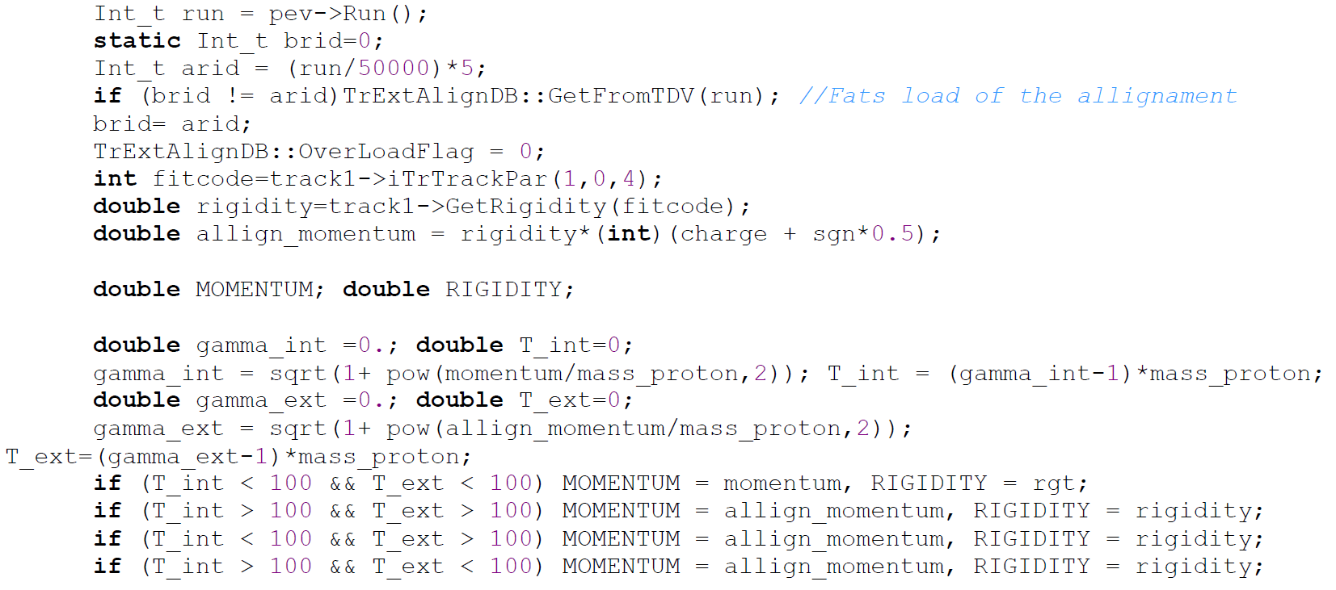
Another alligned momentum from Perugia (doesn’t work)
Low Energy momentum
Different rigidity for low and high energy range
High Energy momentum

Slide 13
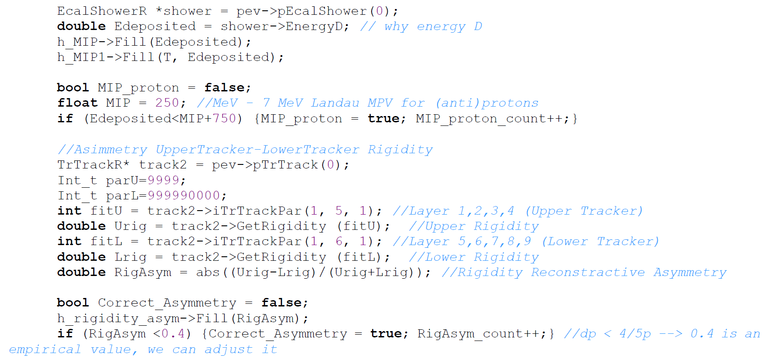
E/p cut
Energy MIP Condition
Rigidity Condition
(two algorithms)

Slide 14
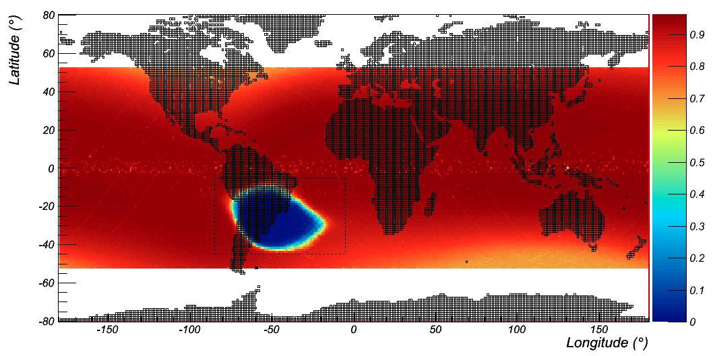
Live Time

Slide 15
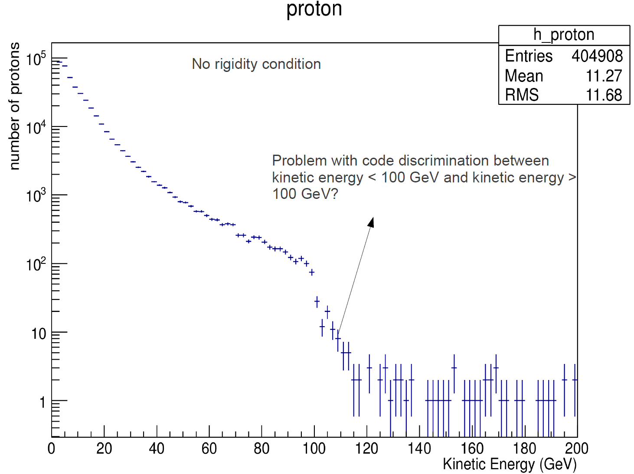
With ECAL
Acceptance and resolution factors
Only few protons

Slide 16
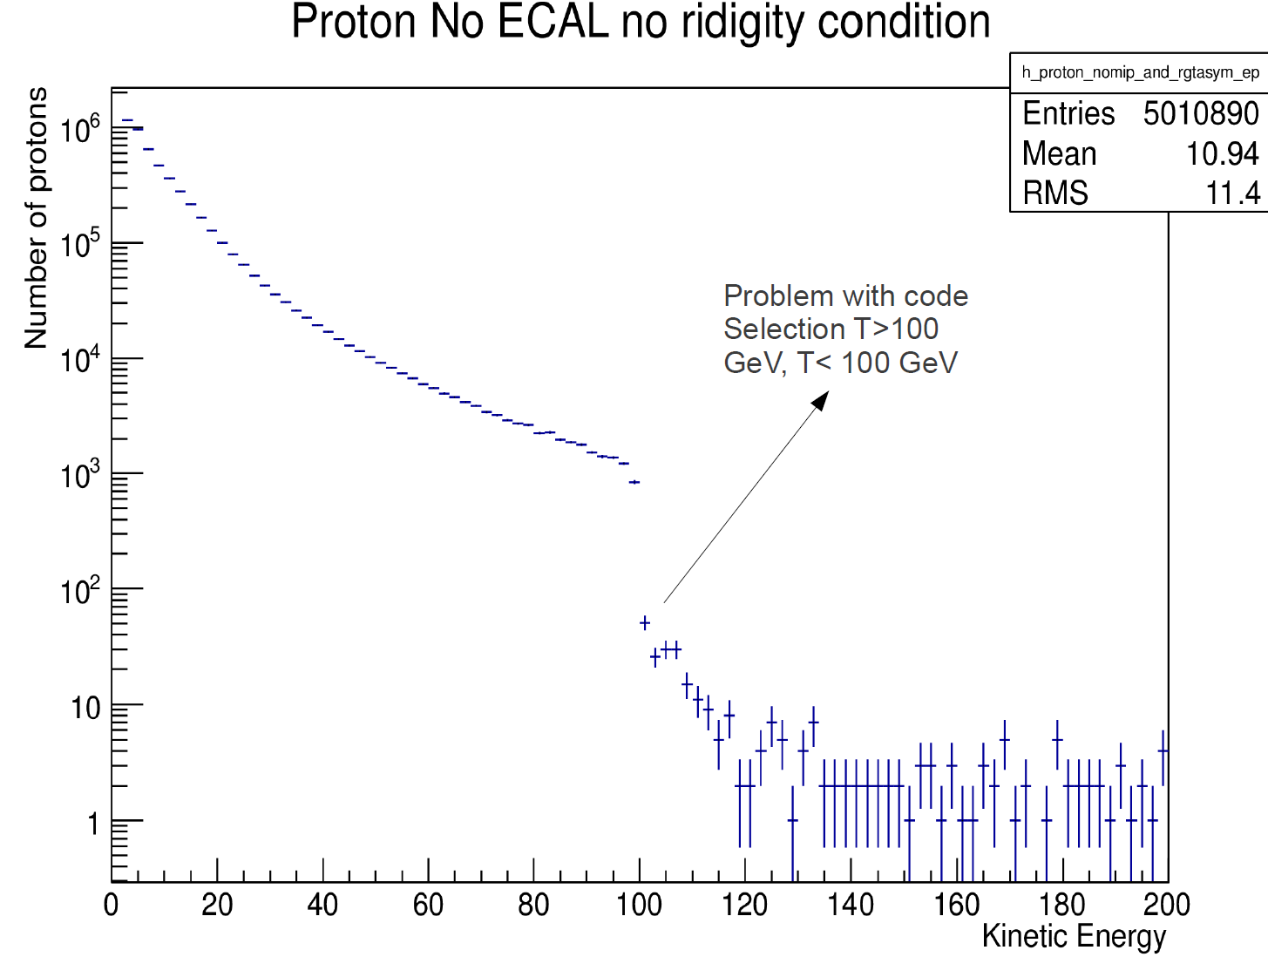
Two order under the expected one
(see table without acceptance factor)
One order of magnitude of difference, respect to ECAL one
We should have to use the same momentum

Slide 17
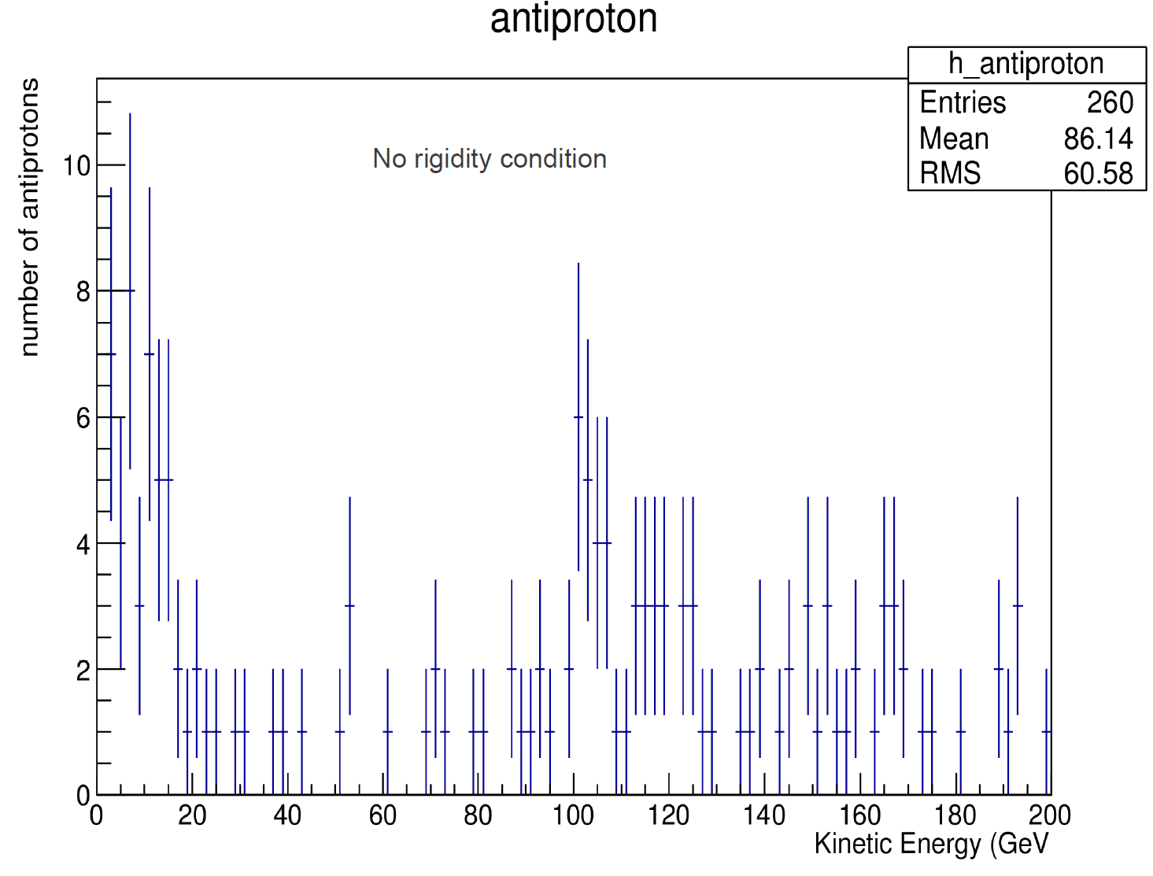
With ECAL
Misleading bump @ 100 GeV

Slide 18
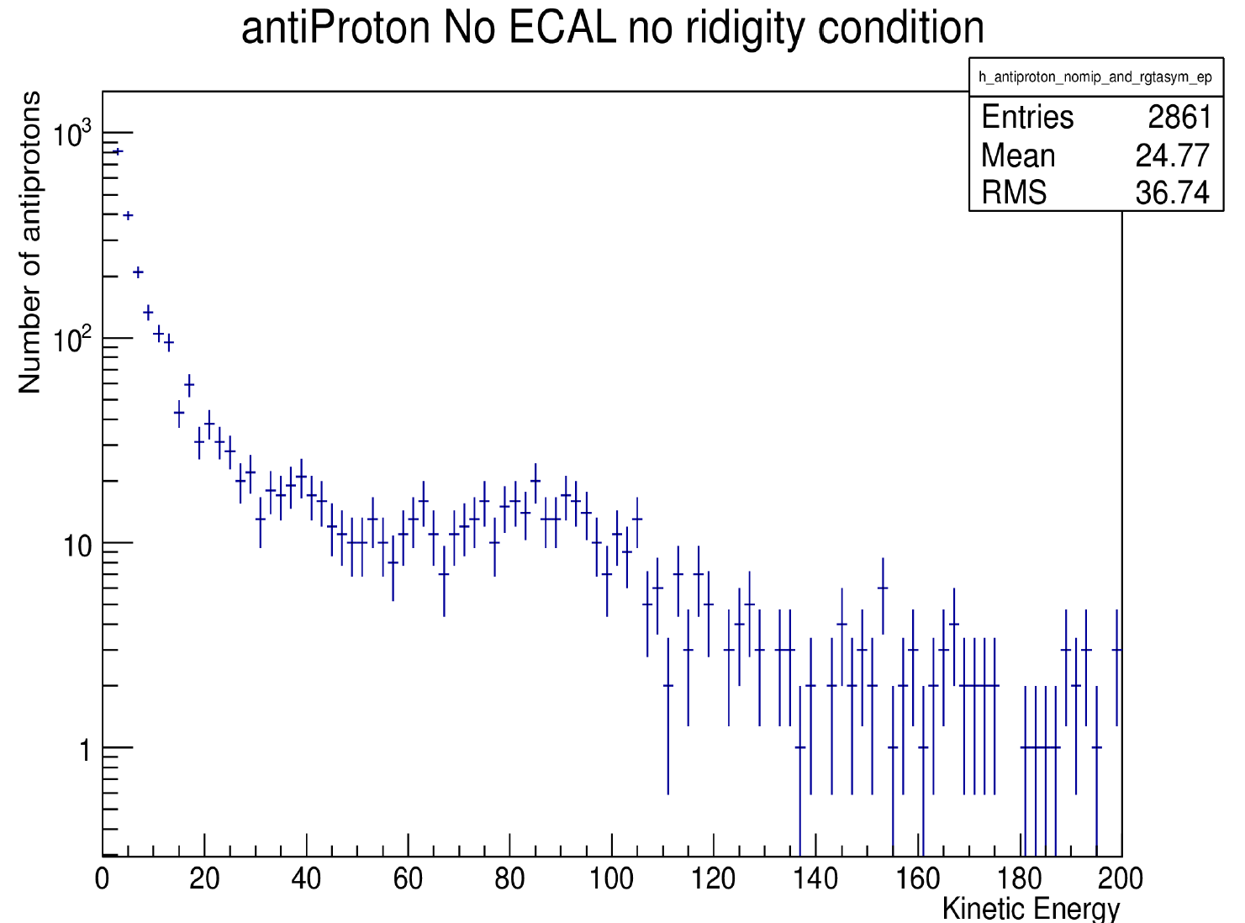
100 antip @ 10 GeV versus 1000 expected without acceptance factor
$$\sim 100 antiprotons beyond$$
$$100 GeV: more than expected →electrons background?$$
1 order more
1 order less

Slide 19
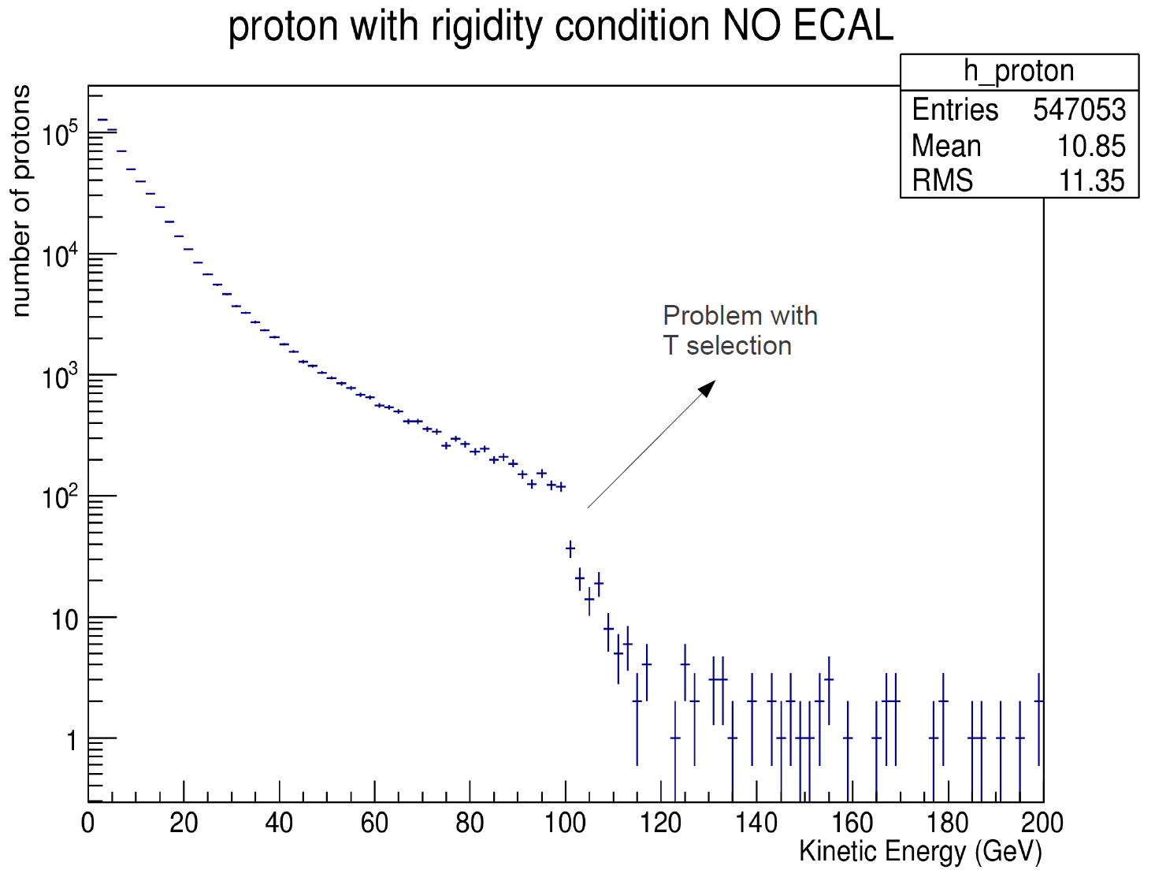
One order of magnitude less than protons without any condition

Slide 20
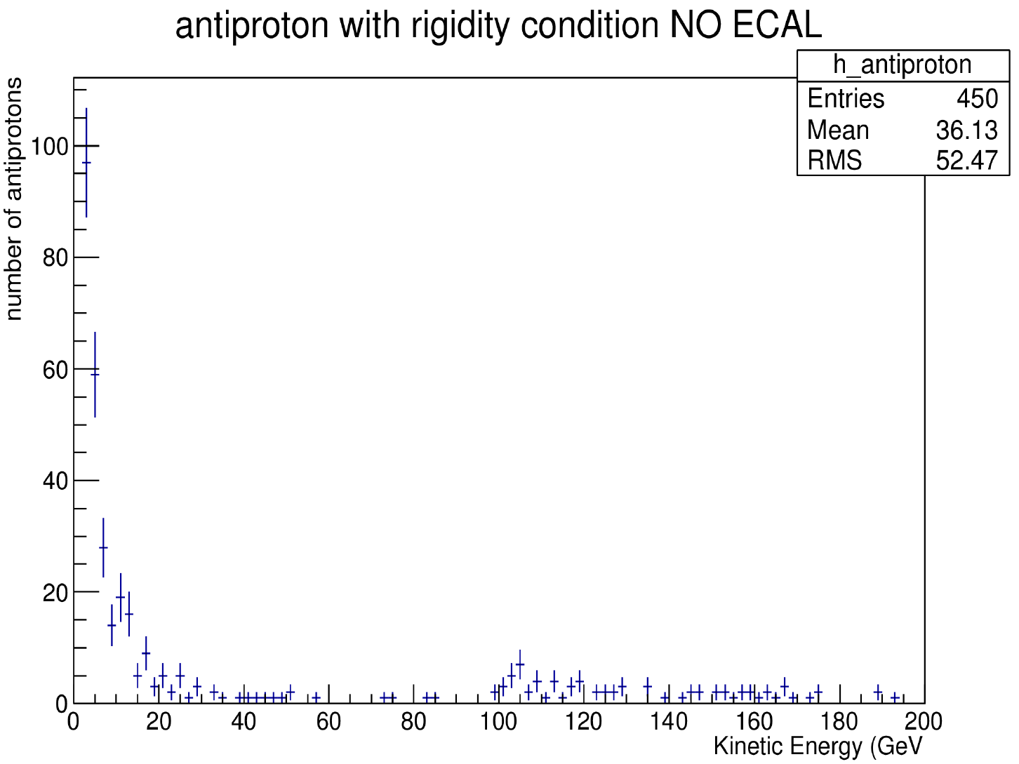

Slide 21
Unfolding
RooUnfold 1.1.1 @ CNAF: iterative Bayesian approach by D’Agostini
Iterative procedure starting from Bayes Theorem $Posterior ∝Likelihood ∗Prior$:
$x_{C}=\left\{x\left(C_{1}\right),x\left(C_{2}\right),…x\left(C_{n_{C}}\right)\right\}$ is the events ensemble in each bin of the distribution, i.e. the true spectrum
$x_{E}=\left\{x\left(E_{1}\right),x\left(E_{2}\right),…x\left(E_{n_{C}}\right)\right\}$ is the observed spectrum
$Λ$ is the smearing matrix, whose elements $λ_{ij}$are defined in probabilistic terms as:
$$λ_{ij}=P\left(E_{j} | C_{i}, I\right)≈L\left(D | T,ℳ\right)≈{x\left(E_{j}\right)}^{MC}/{x\left(C_{j}\right)}^{MC}$$
and , in a naive algebraic rapresentation:
$E\left[x_{E}\right]=Λx_{C} \overset{⇒}{} x_{C}=Λ^{−1}E\left[x_{E}\right]=ℳ_{Unfolding}μ_{E}$
Flat Multidimennsional Step Function Plus Exponential Smoothing
Multinomial or Poissonian Functions

Slide 22
If we define the efficiency:
we can compute the true spectrum with the unfolded data for each bin:
Data
Posterior/Inverse probability calculated with previous Bayes Theorem
Smearing/migration effect
Software Input:
$Λ −$Migration/Smearing Matrix for AMS from MC
$P(C_{i}, I$) - Prior, calibrated after iterative steps, using a $χ^{2}$estimator
$S −$Smoothing Function -> exponential regularization
$N −$Number of iterations after which $P(C_{i}, I$) and $x\left(C_{i}\right)$ converge
$ℰ_{x\left(C\right) }$- Type of error calculation associated

Slide 23
Rootfiles filtering
Right now not too practical:
A lot of functions that would be fixed - for example all the fitcode=track->iTrTrackPar(A,B,C) – a certain ignorance about the indispensable variables
We have to wait for :
New rigidity allignament from Zuccon
New TRD Likelihood Method for High Energy
New BDT-like variables from ECAL for High Energy
New TOF hadron/lepton selection criteria

Slide 24
e/p TOF Selection Criteria
Number of Hits
Energy deposited per Raw Cluster
Time interval/diference

